Slide 1
DEPLOYING PYTHON APPLICATION USING VARIOUS METHODS
- Bairagoni Bhargavi

Slide 2
AGENDA
Using manual method
Userdata
Bash script
Jenkins
Terraform
Terraform, Jenkins, git, github
Docker
K8s
Pipeline

Slide 3
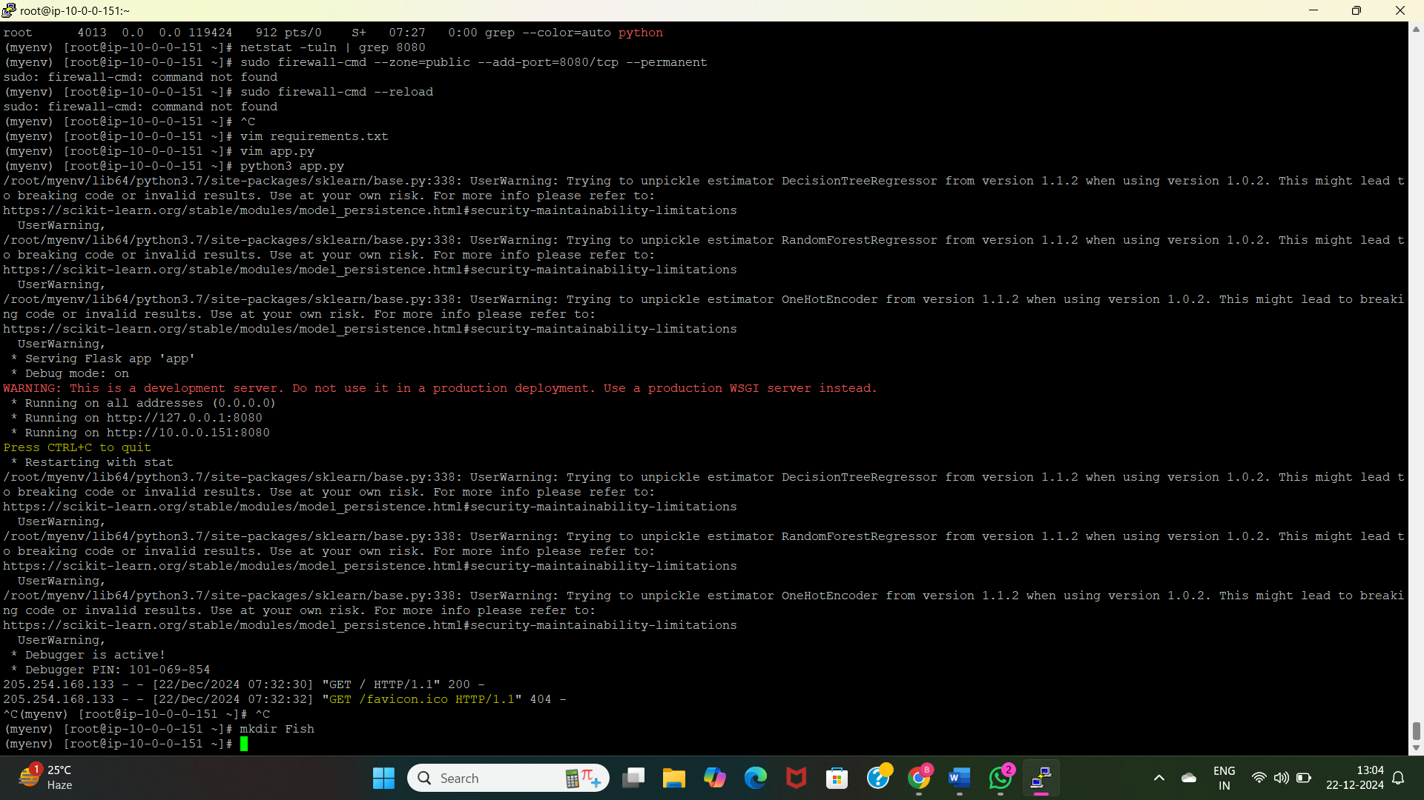
1. Build and deploy python applications in manual process
Create Virtual Private Network to deploy the python application.
Install python and dependencies manually on the terminal where we are having application using “sudo yum install python3-pip”.
Clone the application repository.
Install dependencies using “pip3 install –r requirements.txt”
Run the application using python app.py

Slide 4
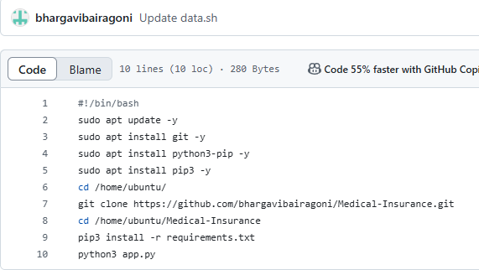
2. Build and deploy python applications along with EC2 instance(userdata)
Create VPC for deploying python application.
Launch an EC2 instance using above created VPC.
Write User Data script by specifying configurations, and github url.
Application runs automatically on instance launch.

Slide 5
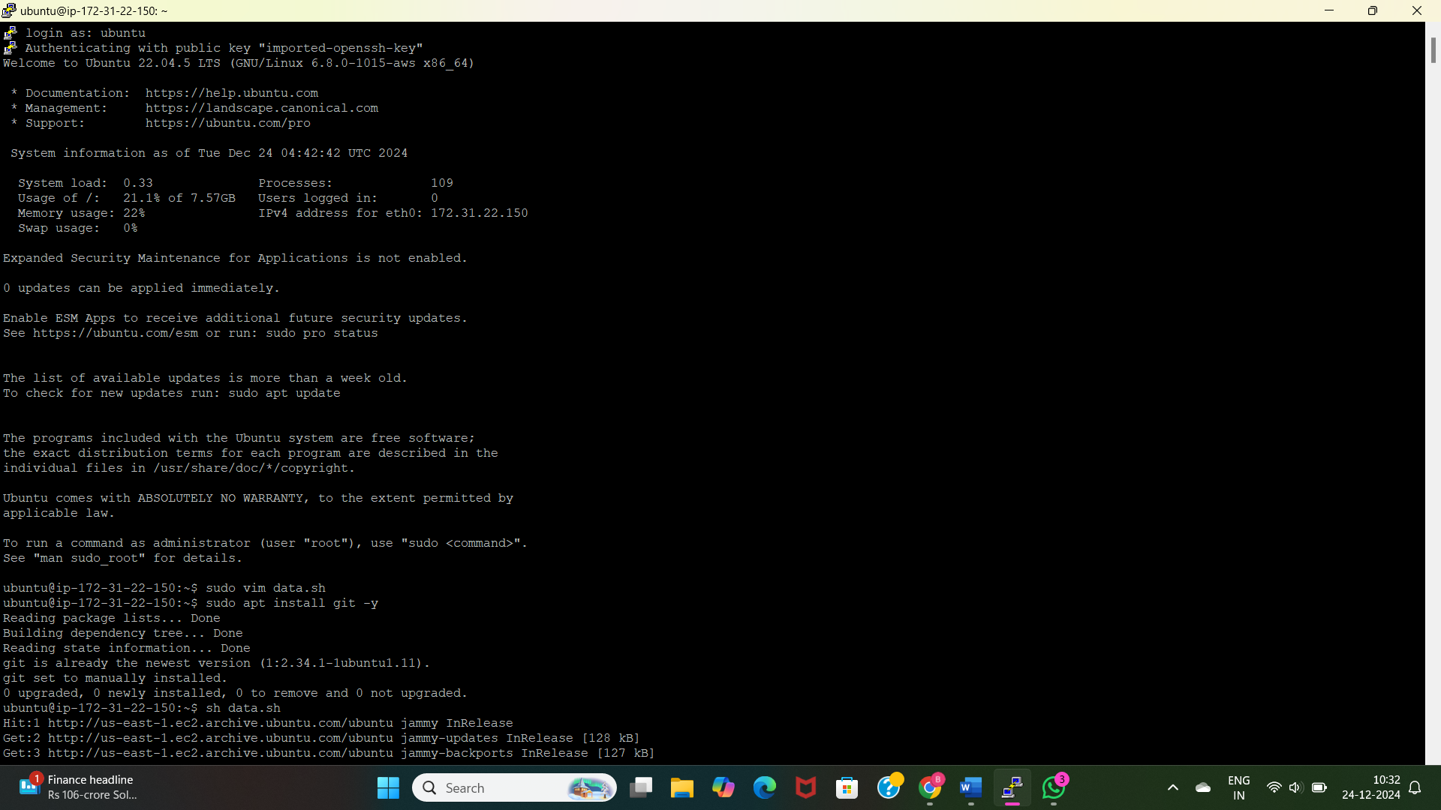
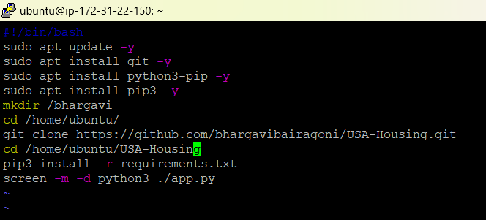
3. Build and deploy python applications in Bash scripting
Write bash script file. data,.sh to deploy python application
Install python “sudo yum install python3”
Install dependencies using “pip3 install –r requirements.txt”
Run application using “python3 app.py” or “screen –m –d python3 ./app.py &&”.

Slide 6
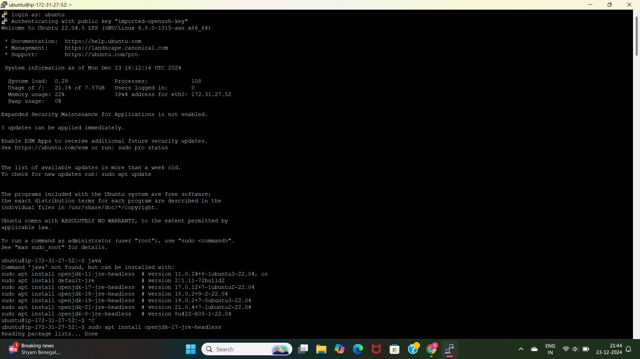
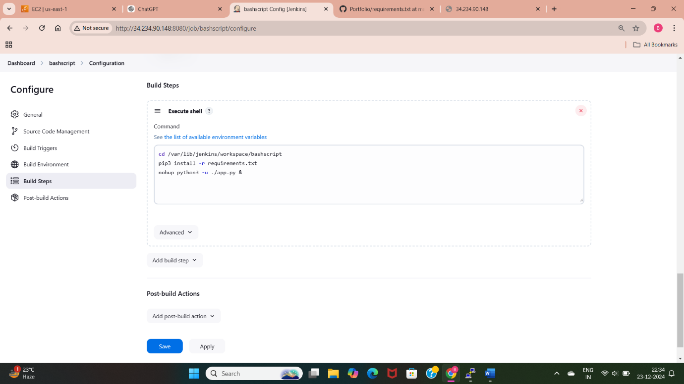
4. Build and deploy python applications with Git, Github and Jenkins (execute shell)
Launch a ec2 instance
Setup Jenkins environment
Create Jenkins job.
Take the github code into Jenkins
Run the commands in execute shell
Build the job.

Slide 7
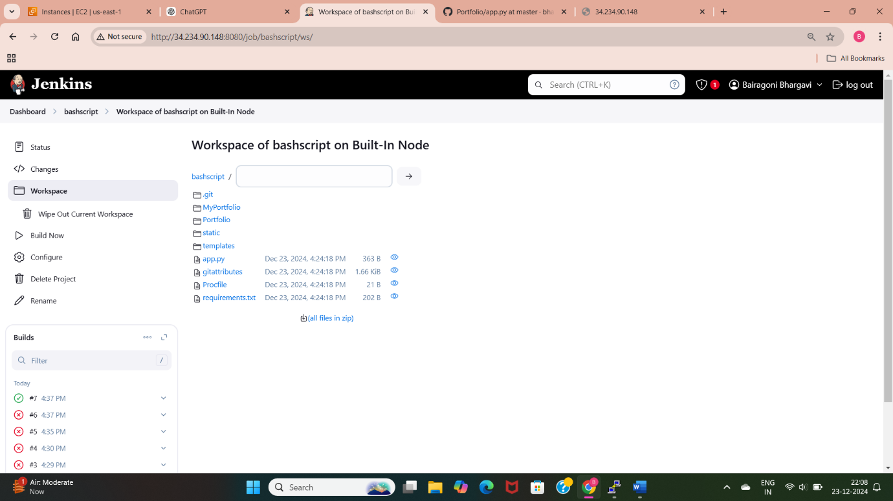

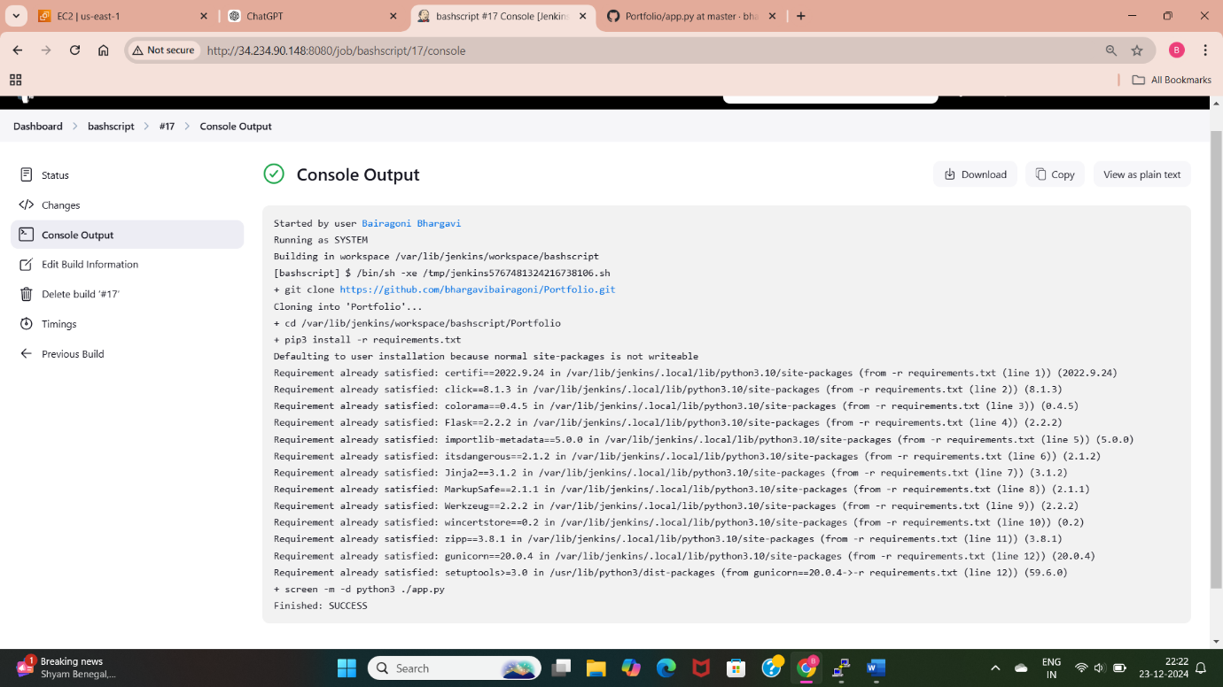

Slide 8
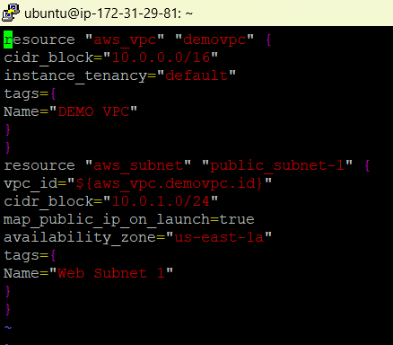
5. Build and deploy python applications with the Terraform(data.sh) and push the Terraform Scripted files in Github
Create a instance and install Jenkins.
Provide AWS configurations to instance.
Create the terraform files for launching ec2 instance, VPC, route table, IGW.
Initialize the terraform in the created files.
Run the “terraform apply” to create the terraform resources.

Slide 9
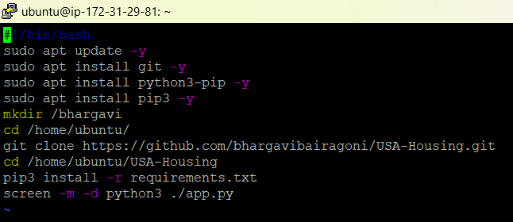
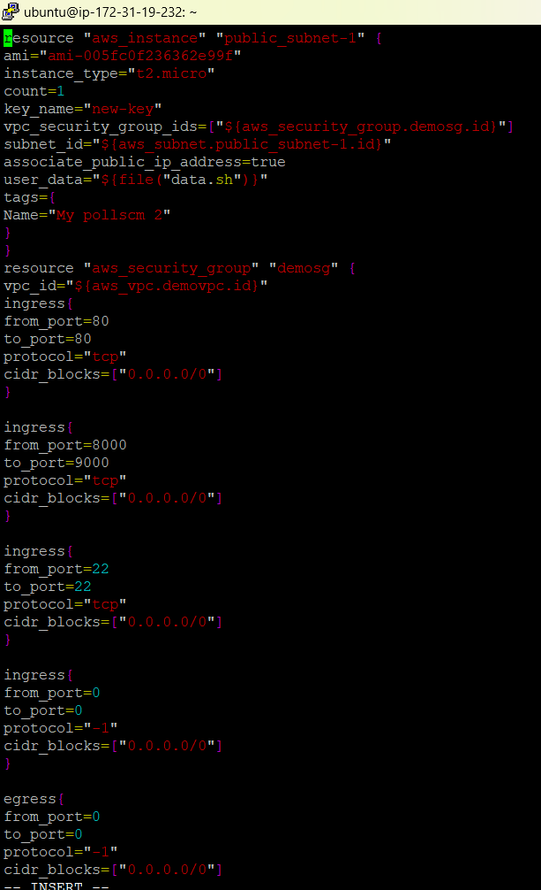
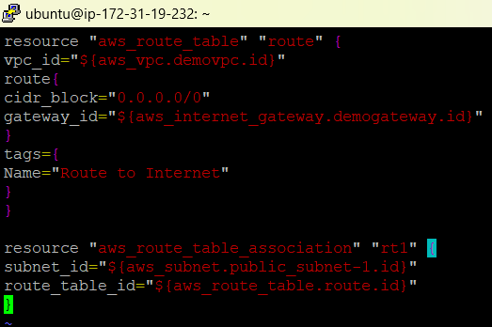
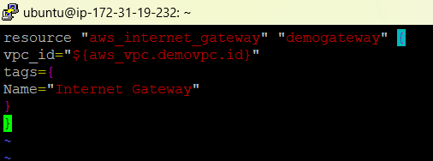

Slide 10
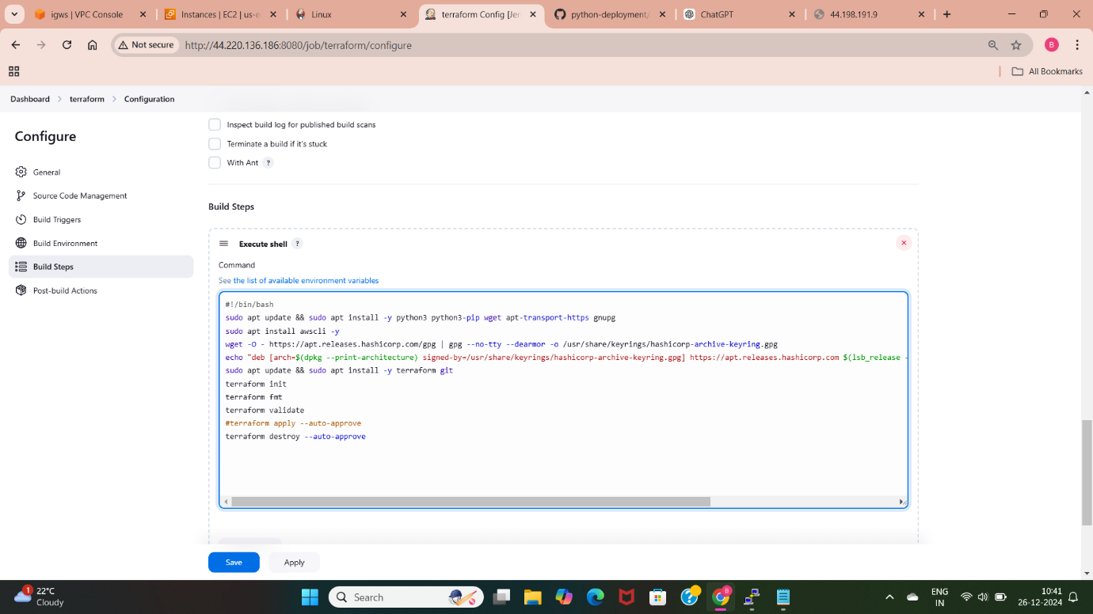
6. Build and deploy python applications with Git, github, Jenkins and Terraform
Setup Jenkins environment in the terminal
Create a job and install aws credentials plugin
Give aws credentials using manage Jenkins and global credentials
Provide installations commands for terraform, awscli, python, pip in execute shell of Jenkins job.
Click on “build now” in the Jenkins job.
Check with the builds and access the application

Slide 11
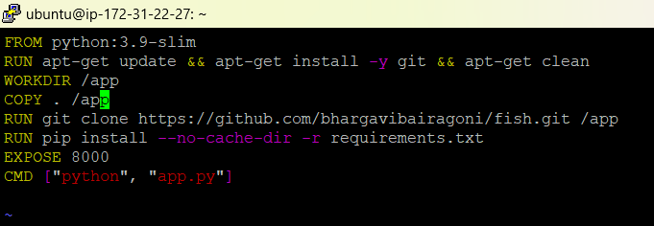
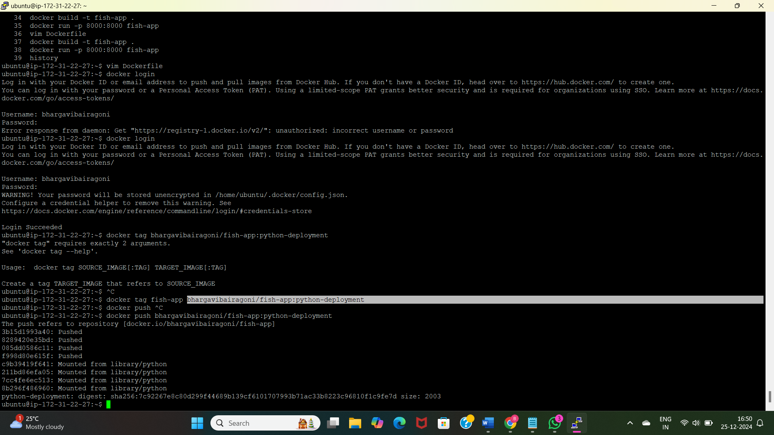
7. Build and deploy python applications with Docker
Launch a ec2 instance and connect with the terminal.
Install and start docker.
Write dockerfile to deploy the application.
Build the image using “docker build -t my-python-app .”
Run the image using “docker run -p 8000:8000 my-python-app”
Acess the application with the instance public IP and the port number.
Push Image to Docker Hub

Slide 12
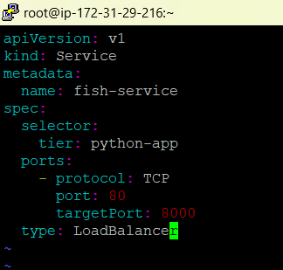
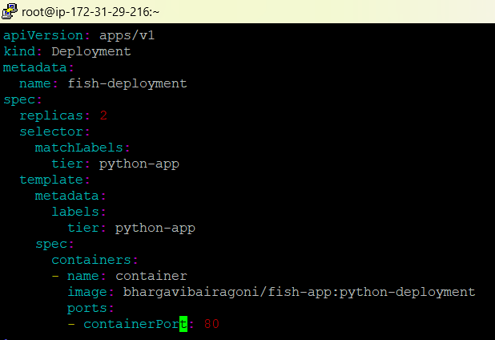
8. Build and deploy python applications with Docker and k8's
Setup the kops cluster in the instance.
Create two clusters one is node and control plane.
Write the deployment file and use the docker image of python application.
Write service file to expose the application.
Access the application using service file url(load balancer url).

Slide 13
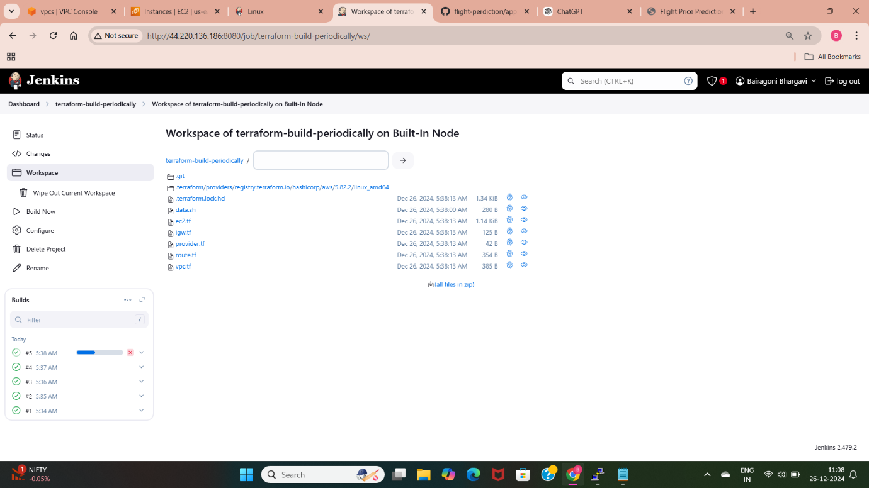
9. Build and deploy python applications with the Git, github, Jenkins and Terraform
Setup Jenkins and create Jenkins job.
Build Periodically: Schedule builds.
Write execute shell and select build periodically triggering method.
PollSCM: Trigger builds based on code changes.
Webhooks: Real-time triggers from GitHub.
Enable webhooks in github repository.
Check with the builds by using these three methods.

Slide 14
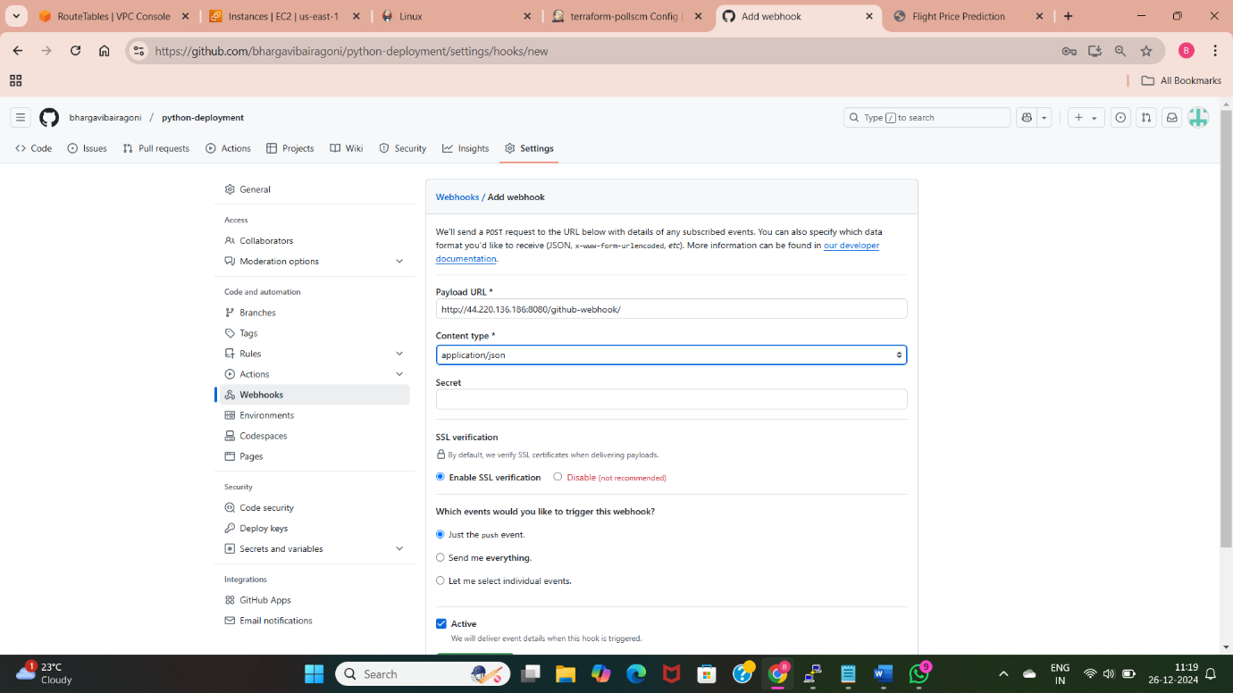
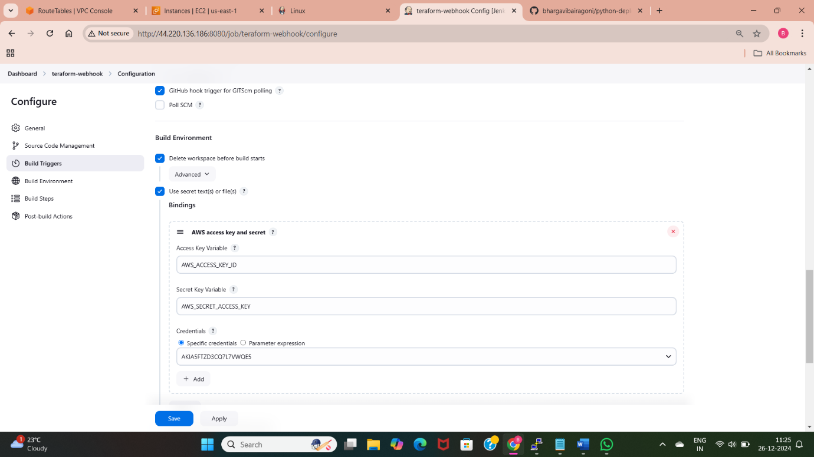
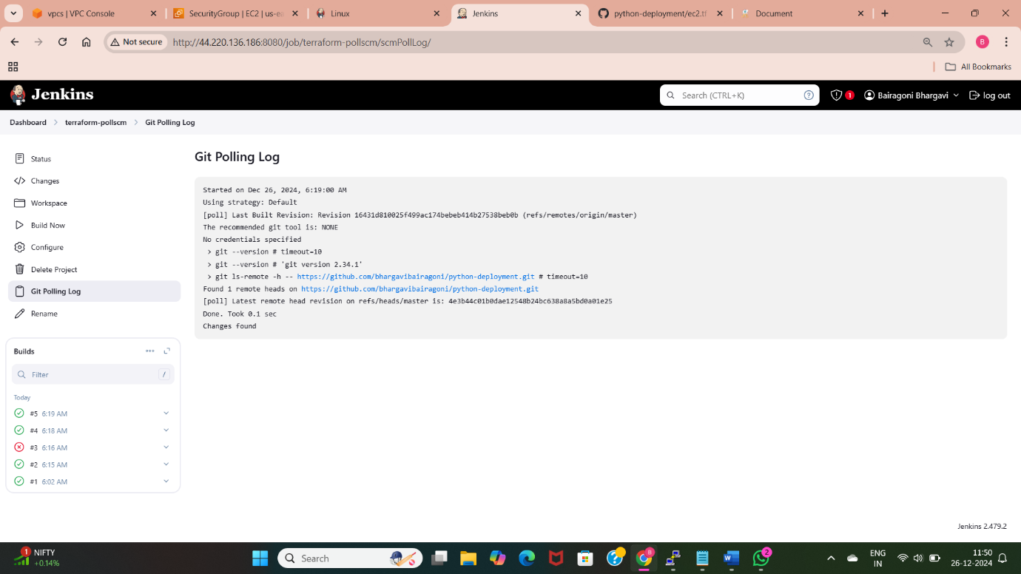
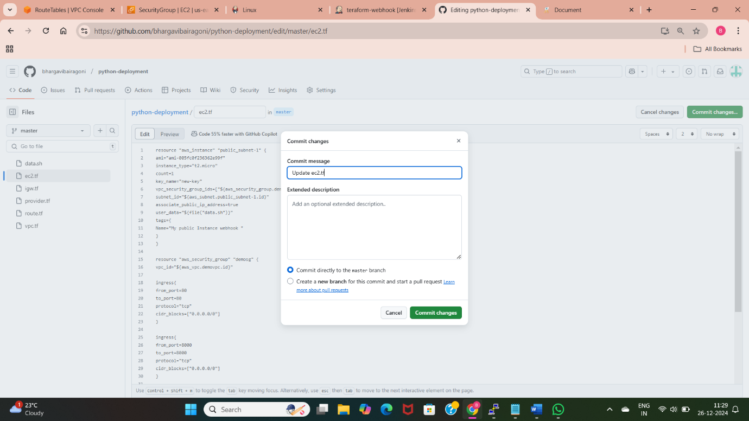

Slide 15
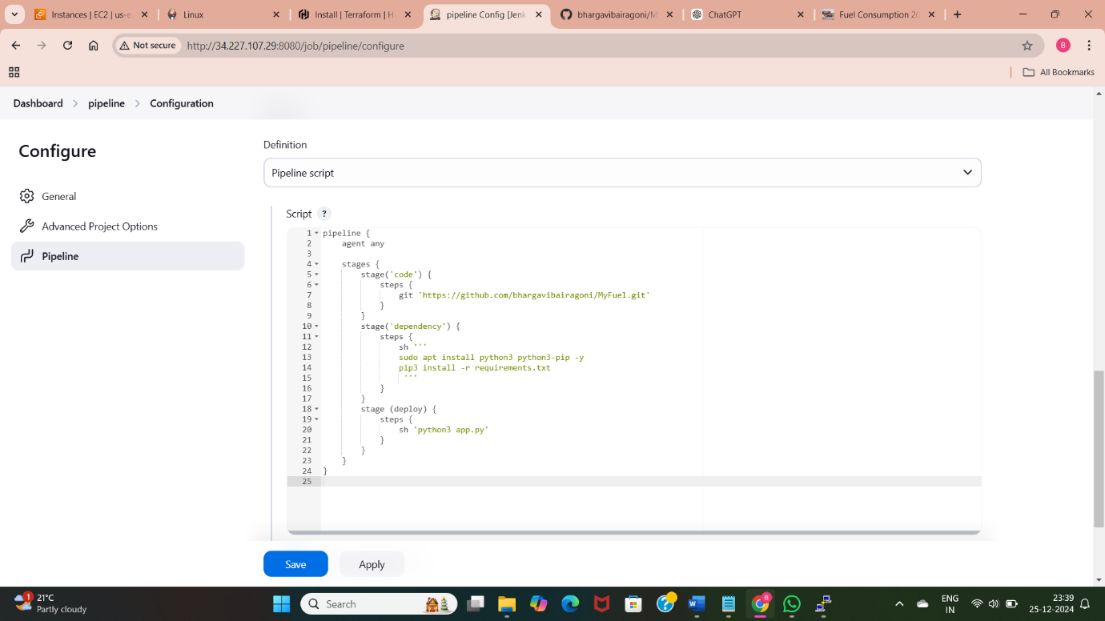
10. Build and deploy python applications with pipeline method with Build periodically, pollscm and webhooks
Create a pipeline job in Jenkins.
Create a pipeline with three stages “code”,”dependency”,”deploy”.
Select triggering methods by using syntax and enabling webhooks in github and check with each method.

Slide 16
THANK YOU

